Slide 1
Form Input Validation

Slide 2
What is Form Input Validation?
The topic of this discussion is called “Form Input Validation”. You may have heard:
Form Validation
Form Data Validation
Input Validation
Field Validation
Input Data Validation

Slide 3
High Level Description of Validation
There are a few types of validation. These are not “official” definitions, but my interpretations based on research for this presentation.
Required vs. Optional – This type of check simply determines if required field in a form contain an entry. It does not check the entry for correctness.
Validation against constraints – This type of check ensures the data entered is sensible and reasonable. For example if you create a form requiring an address it wouldn’t make sense if there were numbers in the state field.
There are three categories of HTML5 validation features:
HTML attributes on <input>, <select>, and <textarea> elements
CSS pseudo selectors
JavaScript API’s

Slide 4
High Level Description of Validation- cont’d
There are also two types of form validation
Client-side validation – this validation occurs in the browser. The user input is checked against the rules and constraints built into the HTML5 or JavaScript and instant feedback is returned to the user.
Server-side validation – this occurs after the data has been submitted. The rules have the potential to be more complex and the data can be scrubbed. For example, a client-side validation can check and email address to see that it’s in the correct email address form. A server-side validation can check to see if the email is already in use on the site. Server-side validation is not as user friendly because the validation occurs after the entire form has been submitted.
For the purpose of this presentation we will focus on Built-in form validation using “validation attributes” occurring on the client-side.

Slide 5
Why Is Validation Important?
Ensures data needed for any calculations is entered
Controls the format for the needed input
Can create a better user experience by paying more forcing more thought to initial form creation.

Slide 6
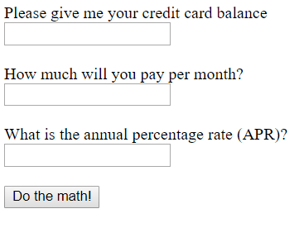
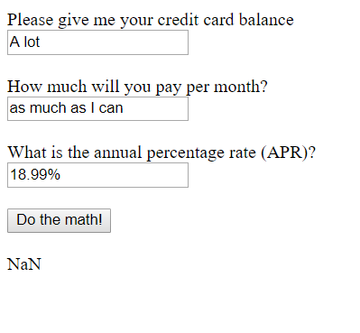
Form Example
Here is an example of a crude form I made for an early HTML class.
There is no form validation and nearly no input instruction:
The user can enter anything, the likely result an invalid answer:

Slide 7
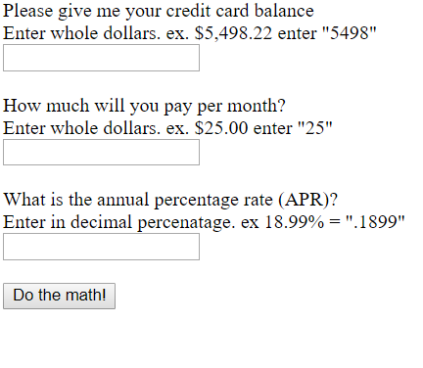
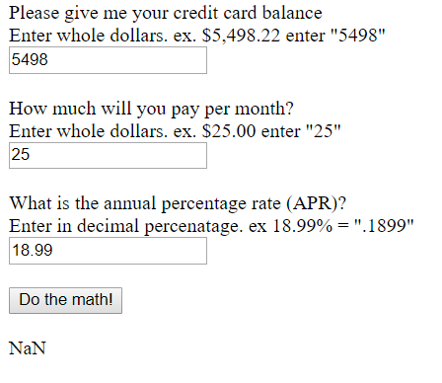
Example with Better Instructions:
Adding more specific entry instructions will help increase the chances of valid entry:
But what happens if the user has a typographical error, or simply doesn’t understand the instructions?

Slide 8
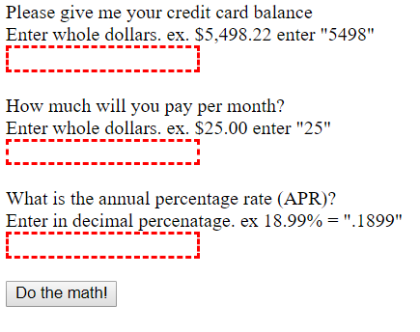
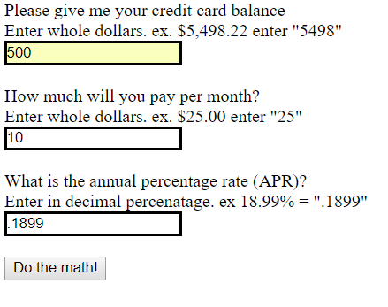
Example with Validation of Required Fields
Below is a screenshot of the same form modified to “require” entry into each field. CSS has been added to show distinguish fields needing entry.
These fields can be made dynamic using CSS, that is, changing appearance when the required entry is fulfilled.

Slide 9
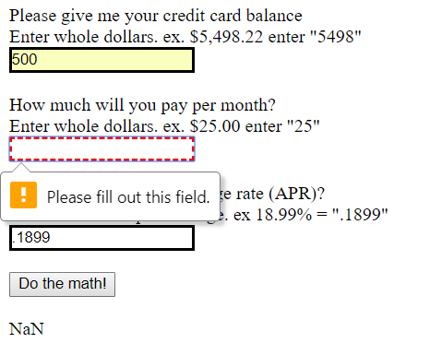
Example with Validation of Required Fields
If the user attempts to submit without the required validation and error message will display.
This is accomplished by adding instruction to the HTML (see red instruction):
<label for="mopmt">How much will you pay per month? <br>
Enter whole dollars. ex. $25.00 enter "25" <br></label>
<input id="pmt" name="pmtamt" required><br><br>
And to the CSS:
input:invalid { border: 2px dashed red; }
input:valid { border: 2px solid black; }
The instruction “required” returns a value of either “invalid” or “valid” to the input element. This allows the CSS to apply the designated styling.

Slide 10
Other Validations
There are a number of other ways to use validation. A great way to learn the general concept is to use the tutorials at W3 Schools. There are many other tutorials available and can be found by doing a google search on Form Input Validation. The ways can be simple or complex but are too numerous to teach here. A few examples:
Pattern validation – This can help validate items expected to be in a specific pattern like phone numbers or social security numbers. Also can be used to ensure proper text. For example a town should not have numbers so the pattern would contain all letters, dashes, apostrophe’s and spaces.
Restricting or requiring length – text fields created by <input> or <textarea> can be constrained and validated using minlength and maxlength attributes.
Validation of specific input types – if an <input type> is specified the browser will validate what is entered. Thi is common for items such as URL and email
This is a partial list, again the best way to learn is through practice and tutorial.

Slide 11
Avoiding need for Validation
Validation should not be avoided as it is beneficial. However, the need for it can be minimized through good form design. Some ways to create a better user experience with easier to enter forms:
Make sure descriptions of what should be entered are clear
Use a drop-down list when you expect only certain results
For items required in a certain syntax or pattern, show an example of that pattern in the instruction, or create a default value showing in the input box to be keyed over.
Use tools to help users such as date pickers, drop downs, radio buttons and check boxes.
The key to clean and accurate data is a well thought out and validated input form.

